Slide 1

Supervised Learning- Regression
Today’s Agenda
What is Regression?
Types of Regression
Real-World Regression Examples
Intuition Behind Linear Regression
Hands-On Practice
Kahoot(Quiz)

Slide 2
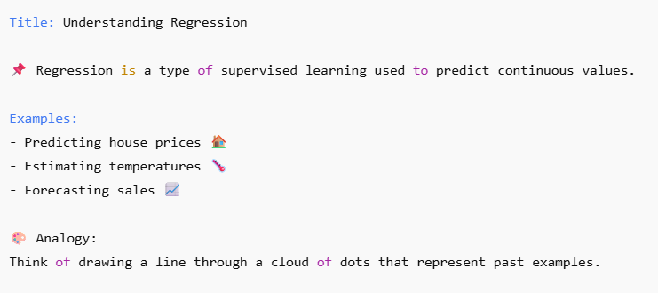
What is Regression?
(Variable) Quantitative data – measurable data
Qual

Slide 3
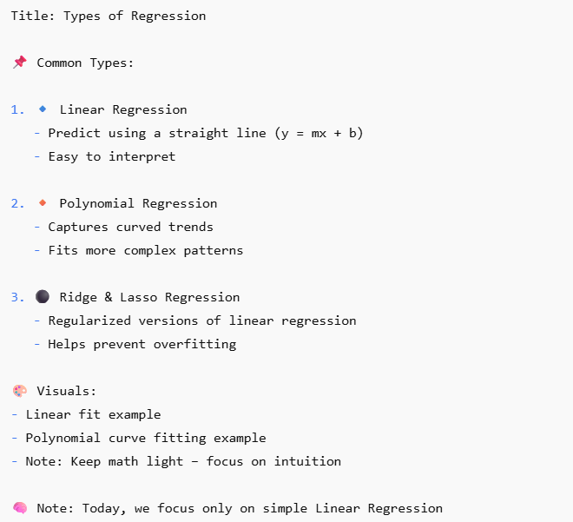
Types of Regression
MAE = Mean(Average) Absolute(Negative lai postivie ) Error(actual – predicated)
[1,2,3,4] [2,4,4,5]
MSE = Mean (average) Squared(model lai thulo galti gareko bhanera dekhauna ko lagi error badhxa )
RMSE = Root() Mean Square (to decrease the value)
Thulo value lai sano ma bujhna sajilo hunxa
R^2= Error used for accuracy visualization

Slide 4
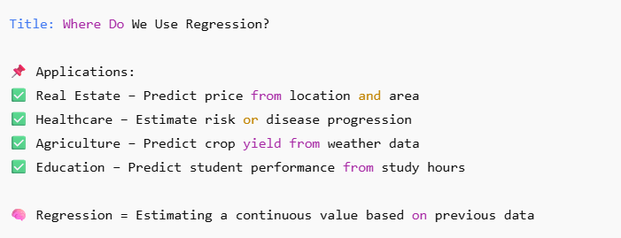
Real-World Regression Examples

Slide 5
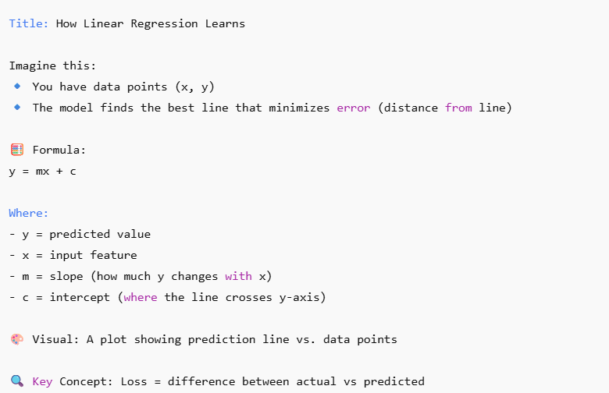
Intuition Behind Linear Regression

